Slide 1

National Health Expenditure Trends, 1975 to 2015
Chartbook
October 2015

Slide 2
Our Vision
Better data. Better decisions. Healthier Canadians.
Our Mandate
To lead the development and maintenance of comprehensive and integrated health information that enables sound policy and effective health system management that improve health and health care.
Our Values
Respect, Integrity, Collaboration, Excellence, Innovation

Slide 3
The following slides are provided to reuse in your own presentations. Please cite as follows: Canadian Institute for Health Information. National Health Expenditure Trends, 1975 to 2015. Ottawa, ON: CIHI; 2015.
Additional resources
The following companion products are available on CIHI’s website:
Data tables
Methodology notes
Infographics
Talk to us
For data-specific information:
nhex@cihi.ca
For media inquiries:
media@cihi.ca
www.cihi.ca

Slide 4
This presentation
Infographics
Overview of health spending in Canada
Total health expenditure by source of finance
Total health expenditure by use of funds
Health expenditure in the provinces and territories
Provincial and territorial government health expenditure by age and sex
Provincial and territorial government fiscal position and health expenditures
International comparisons

Slide 5
Infographics

Slide 6
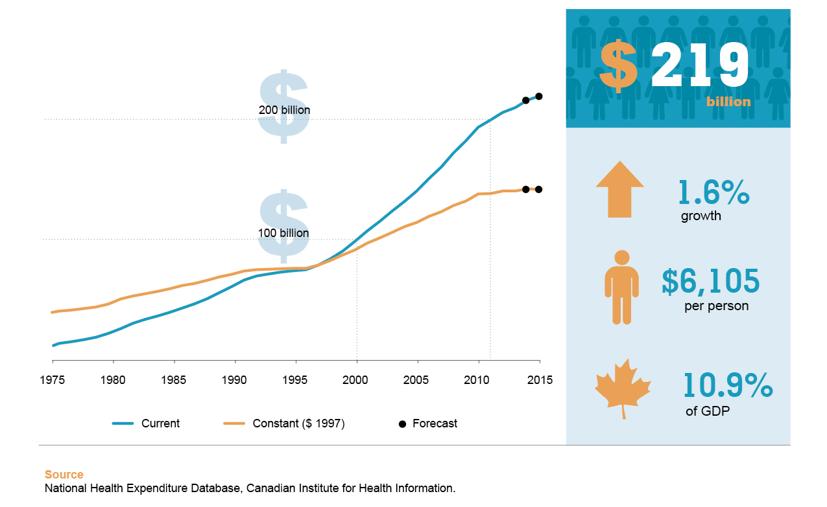
How much will we spend on health in 2015?
© Canadian Institute for Health Information, 2015.

Slide 7
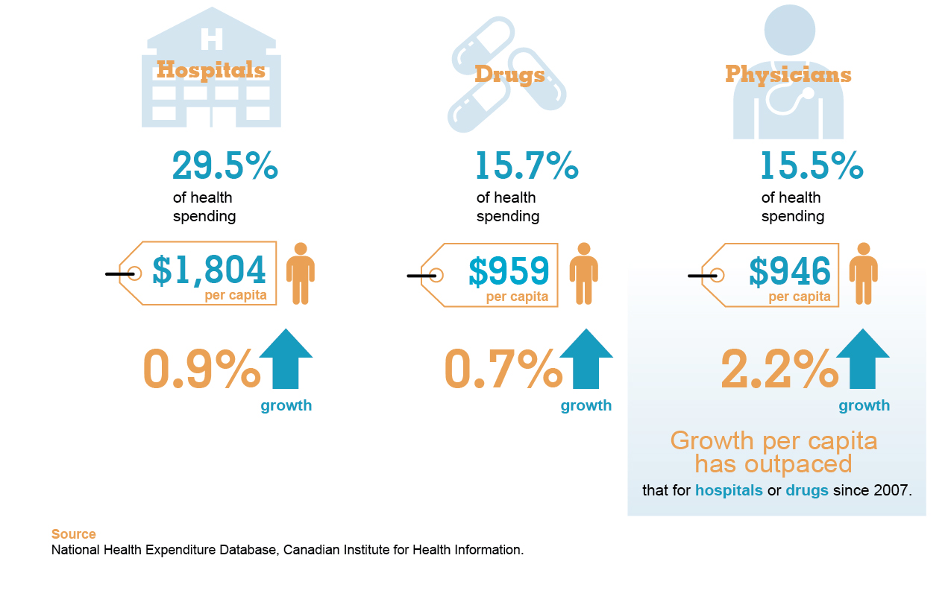
Where is most of the money being spent?
© Canadian Institute for Health Information, 2015.

Slide 8
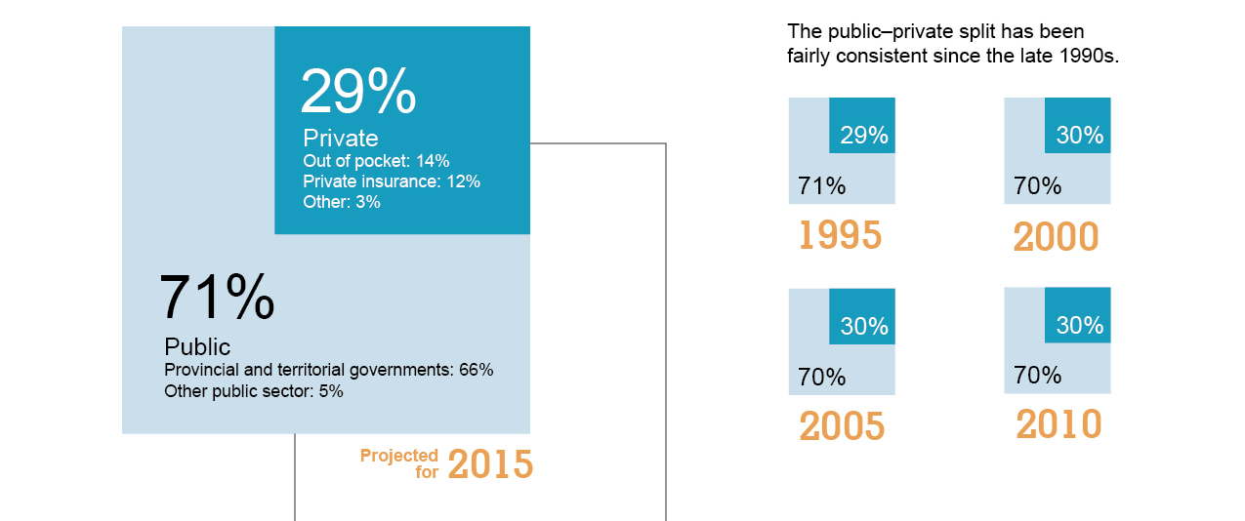
Where does the money come from?
© Canadian Institute for Health Information, 2015.

Slide 9
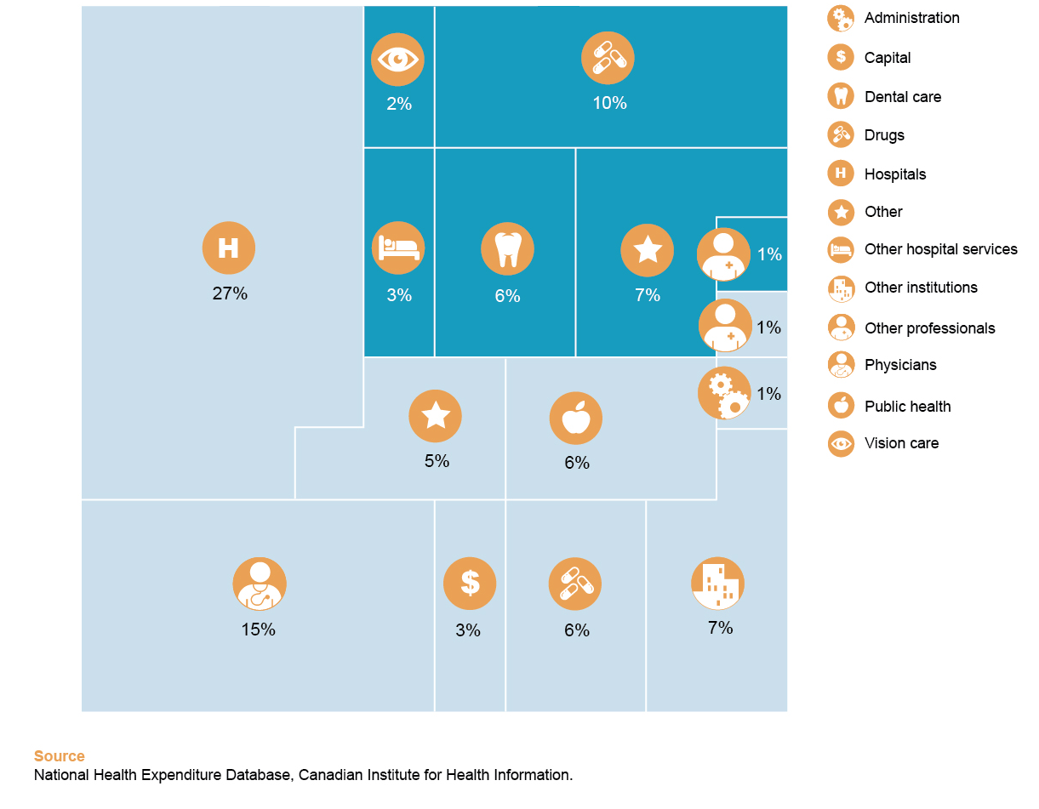
What is the money being spent on?
© Canadian Institute for Health Information, 2015.

Slide 10
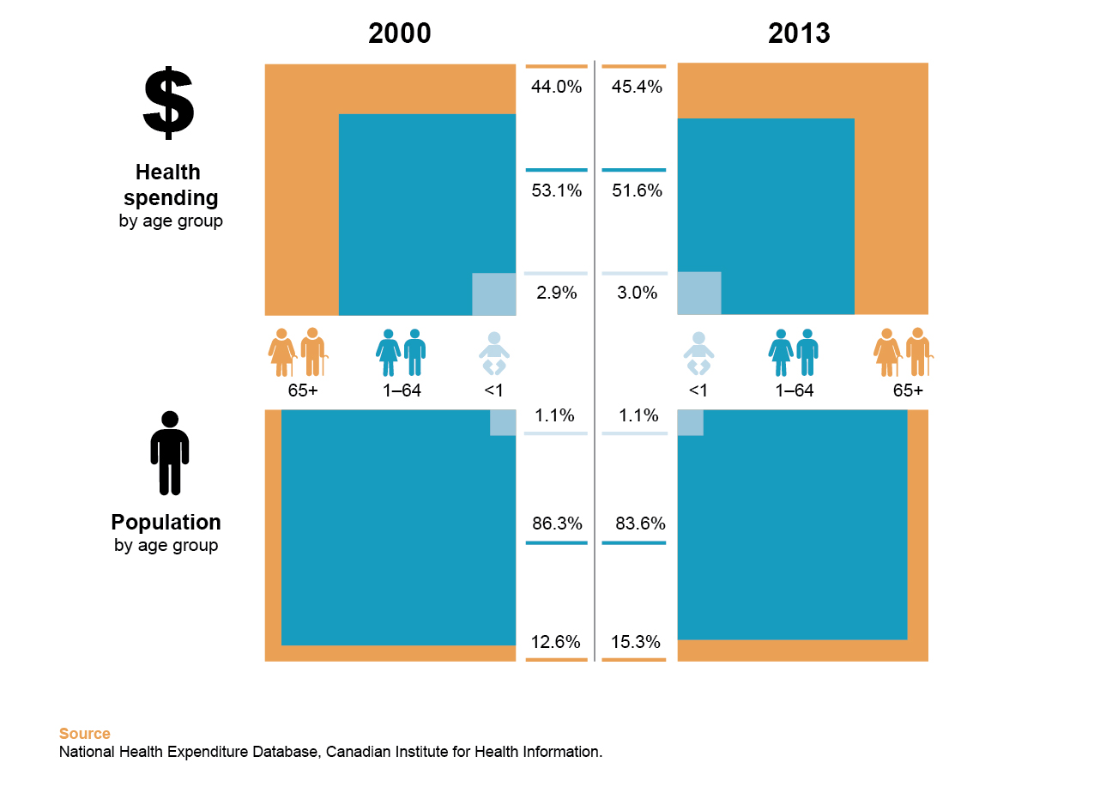
Has health spending on seniors changed?
© Canadian Institute for Health Information, 2015.

Slide 11
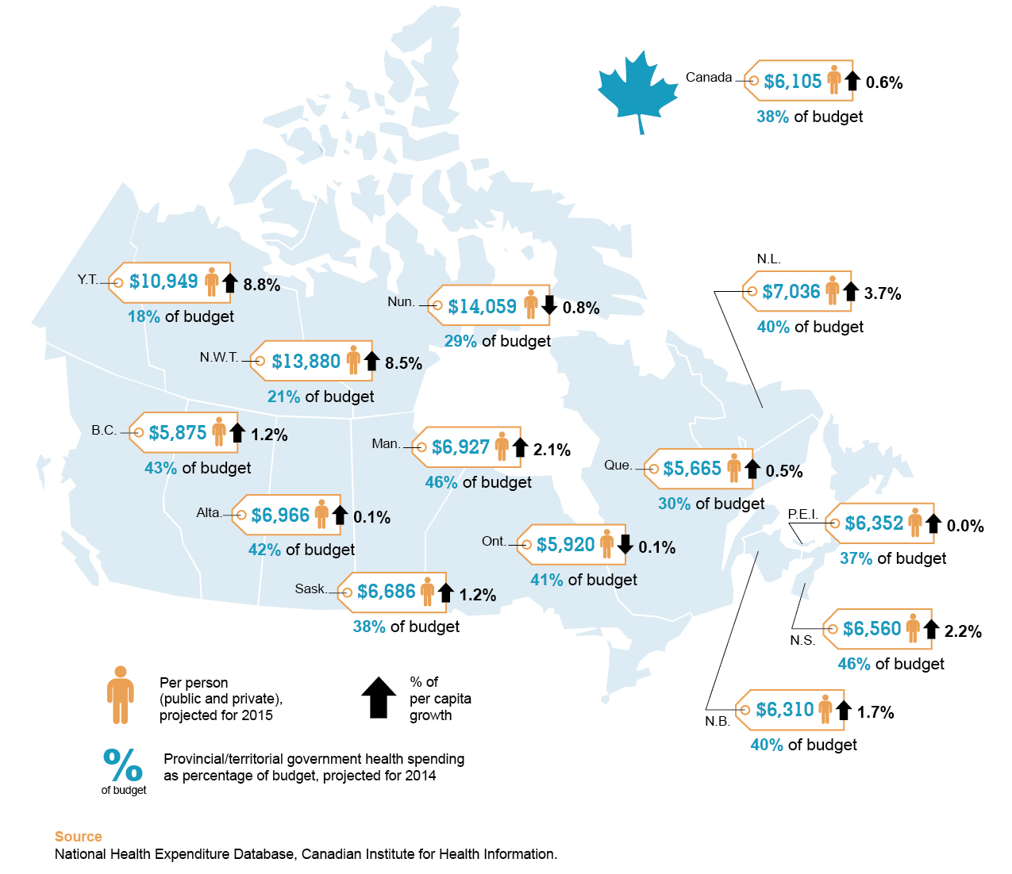
How do the provinces and territories compare?
© Canadian Institute for Health Information, 2015.

Slide 12
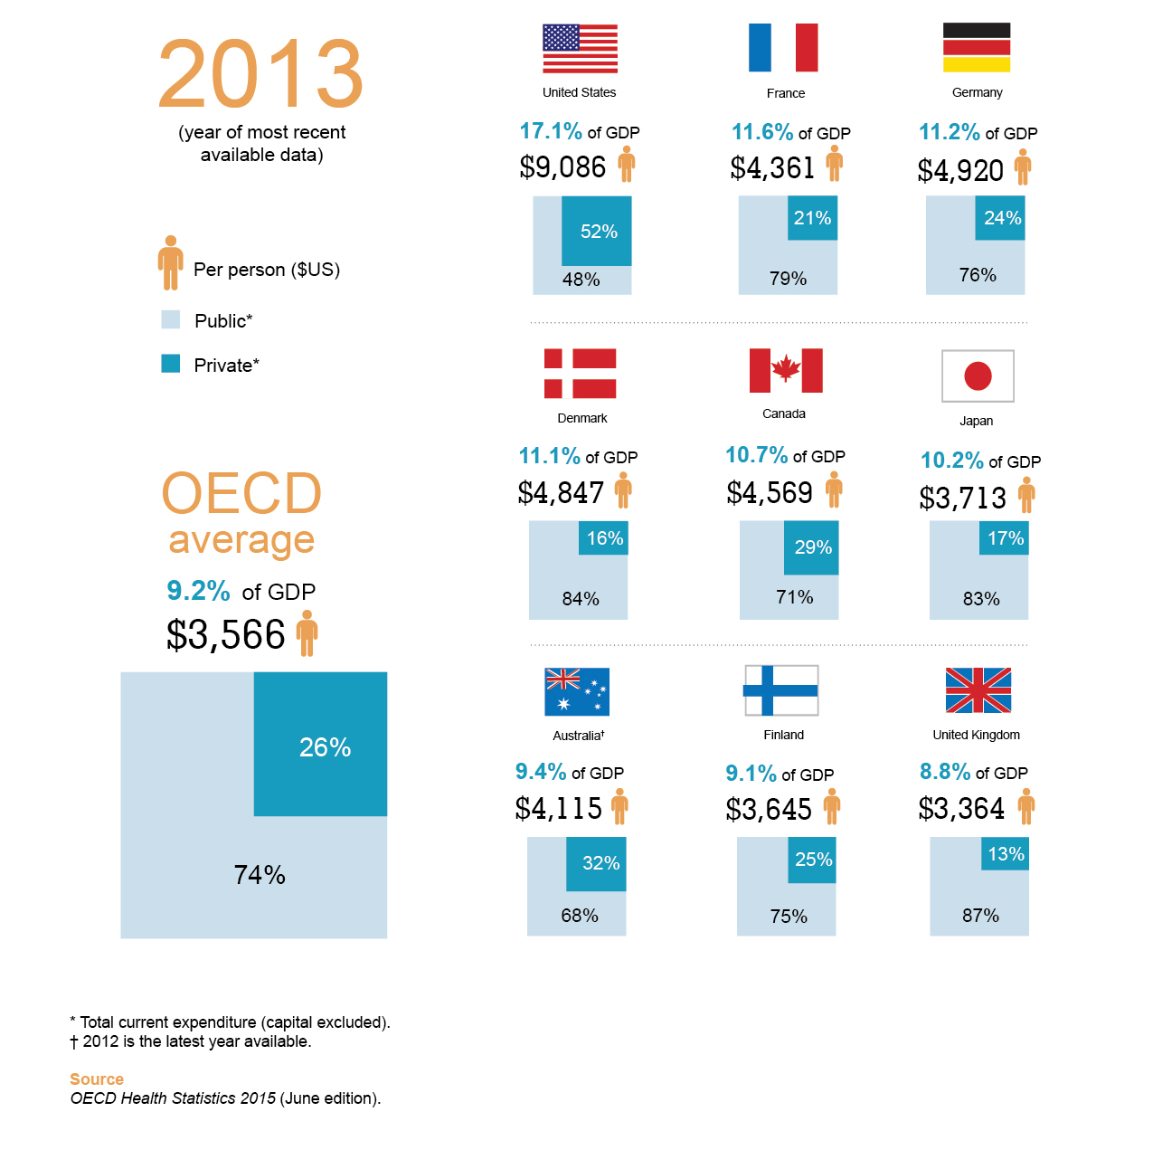
How does Canada compare internationally?
© Canadian Institute for Health Information, 2015.

Slide 13
Overview of health spending in Canada

Slide 14
Growth in health spending has trended slower than inflation and population growth combined since 2010
Sources
National Health Expenditure Database, CIHI; Statistics Canada.

Slide 15
4 distinct periods of growth in health spending since 1975
Sources
National Health Expenditure Database, CIHI; Statistics Canada.

Slide 16
Health spending as a share of GDP has trended upward over the last 40 years
Sources
National Health Expenditure Database, CIHI; Statistics Canada; The Conference Board of Canada.

Slide 17
Growth in health spending and growth in GDP have followed similar trends
Sources
National Health Expenditure Database, CIHI; Statistics Canada; The Conference Board of Canada.

Slide 18
Total health expenditure by source of finance

Slide 19
Trends in public and private health spending
Source
National Health Expenditure Database, CIHI.

Slide 20
Public/private split has remained stable for the last 2 decades
Source
National Health Expenditure Database, CIHI.

Slide 21
Private health spending through health insurance has become more prominent in the past 27 years
Notes
Millions of dollars.
f: Forecast.
Source
National Health Expenditure Database, CIHI.

Slide 22
Provinces’ health spending per person varies by as much as $1,370
Note
f: Forecast.
Sources
National Health Expenditure Database, CIHI; Statistics Canada.

Slide 23
Total health expenditure by use of funds

Slide 24
The share of hospital spending has declined over the last 40 years as shares of spending on drugs and other expenditures have increased
Note
f: Forecast.
Source
National Health Expenditure Database, CIHI.

Slide 25
Hospitals and physicians are funded mostly by the public sector
Canada average
Public | 70.7%
Private | 29.3%
Note
f: Forecast.
Sources
National Health Expenditure Database, CIHI; Statistics Canada.

Slide 26
Growth in drug spending has slowed more than hospital and physician spending
Source
National Health Expenditure Database, CIHI.

Slide 27
The hospital share of public-sector health expenditure has been stable since 2001
Note
Data for 2014 and 2015 is forecast.
Sources
National Health Expenditure Database, CIHI; Statistics Canada.

Slide 28
Drug spending by source of finance and type
Notes
Billions of dollars.
f: Forecast.
OTC: Over the counter, non-prescribed drugs.
PHS: Personal health supplies, non-prescribed drugs.
Sources
National Health Expenditure Database, CIHI; Statistics Canada.

Slide 29
Private-sector share of prescribed drug spending
Source
National Health Expenditure Database, CIHI.

Slide 30
Out-of-pocket and health insurance shares of private prescribed drug spending
Sources
National Health Expenditure Database, CIHI; Statistics Canada.

Slide 31
Public-sector share of prescribed drug spending varies by up to 16.2% among provinces
Note
f: Forecast.
Sources
National Health Expenditure Database, CIHI; Statistics Canada.

Slide 32
Average annual growth of public-sector spending on prescription drugs, last decade versus current decade
Canada average
2000–2010 | 8.3%
2010–2015^{f} | 1.4%
Note
f: Forecast.
Sources
National Health Expenditure Database, CIHI; Statistics Canada.

Slide 33
Provinces’ total drug spending varies by up to $377 per person
Note
f: Forecast.
Sources
National Health Expenditure Database, CIHI; Statistics Canada.

Slide 34
The share of public-sector physician spending recovered to the levels of the late 1980s
Sources
National Health Expenditure Database, CIHI; Statistics Canada.

Slide 35
Dental and vision care services spending per person
Sources
National Health Expenditure Database, CIHI; Statistics Canada.

Slide 36
Other professionals spending by source of finance and type
Note
Billions of dollars.
Sources
National Health Expenditure Database, CIHI; Statistics Canada.

Slide 37
Dental and vision care professionals represent the largest shares
Sources
National Health Expenditure Database, CIHI; Statistics Canada.

Slide 38
Out-of-pocket and health insurance shares of private dental spending
Sources
National Health Expenditure Database, CIHI; Statistics Canada.

Slide 39
Other institutions health spending per person
Sources
National Health Expenditure Database, CIHI; Statistics Canada.

Slide 40
Public-sector other institutions spending as a proportion of total other institutions spending
Sources
National Health Expenditure Database, CIHI; Statistics Canada.

Slide 41
Public health spending as a proportion of total health spending
Sources
National Health Expenditure Database, CIHI; Statistics Canada.

Slide 42
Health expenditure in the provinces and territories

Slide 43
Provincial chapter Newfoundland and Labrador

Slide 44
How has total health spending changed over time?
Newfoundland and Labrador
Source
National Health Expenditure Database, CIHI.

Slide 45
Provincial government health expenditure per capita, annual growth rates*
Newfoundland and Labrador
Note
* Calculated in constant 1997 dollars.
Source
National Health Expenditure Database, CIHI.

Slide 46
Total health spending–to-GDP ratio
Newfoundland and Labrador
Sources
National Health Expenditure Database, CIHI; Statistics Canada; The Conference Board of Canada.

Slide 47
Category shares of total health spending
Newfoundland and Labrador
Note
2015 forecast data.
Source
National Health Expenditure Database, CIHI.

Slide 48
Shares of provincial government health spending by age group
Newfoundland and Labrador
Sources
National Health Expenditure Database, CIHI; Statistics Canada.

Slide 49
Public- and private-sector health spending per person in constant 1997 dollars
Newfoundland and Labrador
Sources
National Health Expenditure Database, CIHI; Statistics Canada; The Conference Board of Canada.

Slide 50
Provincial chapter Prince Edward Island

Slide 51
How has total health spending changed over time?
Prince Edward Island
Source
National Health Expenditure Database, CIHI.

Slide 52
Provincial government health expenditure per capita, annual growth rates*
Prince Edward Island
Note
* Calculated in constant 1997 dollars.
Source
National Health Expenditure Database, CIHI.

Slide 53
Total health spending–to-GDP ratio
Prince Edward Island
Sources
National Health Expenditure Database, CIHI; Statistics Canada; The Conference Board of Canada.

Slide 54
Category shares of total health spending
Prince Edward Island
Note
2015 forecast data.
Source
National Health Expenditure Database, CIHI.

Slide 55
Shares of provincial government health spending by age group
Prince Edward Island
Sources
National Health Expenditure Database, CIHI; Statistics Canada.

Slide 56
Public- and private-sector health spending per person in constant 1997 dollars
Prince Edward Island
Sources
National Health Expenditure Database, CIHI; Statistics Canada; The Conference Board of Canada.

Slide 57
Provincial chapter Nova Scotia

Slide 58
How has total health spending changed over time?
Nova Scotia
Source
National Health Expenditure Database, CIHI.

Slide 59
Provincial government health expenditure per capita, annual growth rates*
Nova Scotia
Note
* Calculated in constant 1997 dollars.
Source
National Health Expenditure Database, CIHI.

Slide 60
Total health spending–to-GDP ratio
Nova Scotia
Sources
National Health Expenditure Database, CIHI; Statistics Canada; The Conference Board of Canada.

Slide 61
Category shares of total health spending
Nova Scotia
Note
2015 forecast data.
Source
National Health Expenditure Database, CIHI.

Slide 62
Shares of provincial government health spending by age group
Nova Scotia
Sources
National Health Expenditure Database, CIHI; Statistics Canada.

Slide 63
Public- and private-sector health spending per person in constant 1997 dollars
Nova Scotia
Sources
National Health Expenditure Database, CIHI; Statistics Canada; The Conference Board of Canada.

Slide 64
Provincial chapter New Brunswick

Slide 65
How has total health spending changed over time?
New Brunswick
Source
National Health Expenditure Database, CIHI.

Slide 66
Provincial government health expenditure per capita, annual growth rates*
New Brunswick
Note
* Calculated in constant 1997 dollars.
Source
National Health Expenditure Database, CIHI.

Slide 67
Total health spending–to-GDP ratio
New Brunswick
Sources
National Health Expenditure Database, CIHI; Statistics Canada; The Conference Board of Canada.

Slide 68
Category shares of total health spending
New Brunswick
Note
2015 forecast data.
Source
National Health Expenditure Database, CIHI.

Slide 69
Shares of provincial government health spending by age group
New Brunswick
Sources
National Health Expenditure Database, CIHI; Statistics Canada.

Slide 70
Public- and private-sector health spending per person in constant 1997 dollars
New Brunswick
Sources
National Health Expenditure Database, CIHI; Statistics Canada; The Conference Board of Canada.

Slide 71
Provincial chapter Quebec

Slide 72
How has total health spending changed over time?
Quebec
Source
National Health Expenditure Database, CIHI.

Slide 73
Provincial government health expenditure per capita, annual growth rates*
Quebec
Note
* Calculated in constant 1997 dollars.
Source
National Health Expenditure Database, CIHI.

Slide 74
Total health spending–to-GDP ratio
Quebec
Sources
National Health Expenditure Database, CIHI; Statistics Canada; The Conference Board of Canada.

Slide 75
Category shares of total health spending
Quebec
Note
2015 forecast data.
Source
National Health Expenditure Database, CIHI.

Slide 76
Shares of provincial government health spending by age group
Quebec
Sources
National Health Expenditure Database, CIHI; Statistics Canada.

Slide 77
Public- and private-sector health spending per person in constant 1997 dollars
Quebec
Sources
National Health Expenditure Database, CIHI; Statistics Canada; The Conference Board of Canada.

Slide 78
Quebec Drug Insurance Fund
© Canadian Institute for Health Information, 2015.
Notes
In millions of dollars. f: Forecast. Source National Health Expenditure Database, Canadian Institute for Health Information.

Slide 79
Provincial chapter Ontario

Slide 80
How has total health spending changed over time?
Ontario
Source
National Health Expenditure Database, CIHI.

Slide 81
Provincial government health expenditure per capita, annual growth rates*
Ontario
Note
* Calculated in constant 1997 dollars.
Source
National Health Expenditure Database, CIHI.

Slide 82
Total health spending–to-GDP ratio
Ontario
Sources
National Health Expenditure Database, CIHI; Statistics Canada; The Conference Board of Canada.

Slide 83
Category shares of total health spending
Ontario
Note
2015 forecast data.
Source
National Health Expenditure Database, CIHI.

Slide 84
Shares of provincial government health spending by age group
Ontario
Sources
National Health Expenditure Database, CIHI; Statistics Canada.

Slide 85
Public- and private-sector health spending per person in constant 1997 dollars
Ontario
Sources
National Health Expenditure Database, CIHI; Statistics Canada; The Conference Board of Canada.

Slide 86
Provincial chapter Manitoba

Slide 87
How has total health spending changed over time?
Manitoba
Source
National Health Expenditure Database, CIHI.

Slide 88
Provincial government health expenditure per capita, annual growth rates*
Manitoba
Note
* Calculated in constant 1997 dollars.
Source
National Health Expenditure Database, CIHI.

Slide 89
Total health spending–to-GDP ratio
Manitoba
Sources
National Health Expenditure Database, CIHI; Statistics Canada; The Conference Board of Canada.

Slide 90
Category shares of total health spending
Manitoba
Note
2015 forecast data.
Source
National Health Expenditure Database, CIHI.

Slide 91
Shares of provincial government health spending by age group
Manitoba
Sources
National Health Expenditure Database, CIHI; Statistics Canada.

Slide 92
Public- and private-sector health spending per person in constant 1997 dollars
Manitoba
Sources
National Health Expenditure Database, CIHI; Statistics Canada; The Conference Board of Canada.

Slide 93
Provincial chapter Saskatchewan

Slide 94
How has total health spending changed over time?
Saskatchewan
Source
National Health Expenditure Database, CIHI.

Slide 95
Provincial government health expenditure per capita, annual growth rates*
Saskatchewan
Note
* Calculated in constant 1997 dollars.
Source
National Health Expenditure Database, CIHI.

Slide 96
Total health spending–to-GDP ratio
Saskatchewan
Sources
National Health Expenditure Database, CIHI; Statistics Canada; The Conference Board of Canada.

Slide 97
Category shares of total health spending
Saskatchewan
Note
2015 forecast data.
Source
National Health Expenditure Database, CIHI.

Slide 98
Shares of provincial government health spending by age group
Saskatchewan
Sources
National Health Expenditure Database, CIHI; Statistics Canada.

Slide 99
Public- and private-sector health spending per person in constant 1997 dollars
Saskatchewan
Sources
National Health Expenditure Database, CIHI; Statistics Canada; The Conference Board of Canada.

Slide 100
Provincial chapter Alberta

Slide 101
How has total health spending changed over time?
Alberta
Source
National Health Expenditure Database, CIHI.

Slide 102
Provincial government health expenditure per capita, annual growth rates*
Alberta
Note
* Calculated in constant 1997 dollars.
Source
National Health Expenditure Database, CIHI.

Slide 103
Total health spending–to-GDP ratio
Alberta
Sources
National Health Expenditure Database, CIHI; Statistics Canada; The Conference Board of Canada.

Slide 104
Category shares of total health spending
Alberta
Note
2015 forecast data.
Source
National Health Expenditure Database, CIHI.

Slide 105
Shares of provincial government health spending by age group
Alberta
Sources
National Health Expenditure Database, CIHI; Statistics Canada.
Notes:
The share of health spending on seniors is lowest in Alberta, although it is increasing.

Slide 106
Public- and private-sector health spending per person in constant 1997 dollars
Alberta
Sources
National Health Expenditure Database, CIHI; Statistics Canada; The Conference Board of Canada.

Slide 107
Provincial chapter British Columbia

Slide 108
How has total health spending changed over time?
British Columbia
Source
National Health Expenditure Database, CIHI.

Slide 109
Provincial government health expenditure per capita, annual growth rates*
British Columbia
Note
* Calculated in constant 1997 dollars.
Source
National Health Expenditure Database, CIHI.

Slide 110
Total health spending–to-GDP ratio
British Columbia
Sources
National Health Expenditure Database, CIHI; Statistics Canada; The Conference Board of Canada.

Slide 111
Category shares of total health spending
British Columbia
Note
2015 forecast data.
Source
National Health Expenditure Database, CIHI.

Slide 112
Shares of provincial government health spending by age group
British Columbia
Sources
National Health Expenditure Database, CIHI; Statistics Canada.

Slide 113
Public- and private-sector health spending per person in constant 1997 dollars
British Columbia
Sources
National Health Expenditure Database, CIHI; Statistics Canada; The Conference Board of Canada.

Slide 114
Territorial chapter Territories trends

Slide 115
Public- and private-sector health spending per person in constant 1997 dollars
Yukon
Sources
National Health Expenditure Database, CIHI; Statistics Canada; The Conference Board of Canada.

Slide 116
Public- and private-sector health spending per person in constant 1997 dollars
Northwest Territories
Sources
National Health Expenditure Database, CIHI; Statistics Canada; The Conference Board of Canada.

Slide 117
Public- and private-sector health spending per person in constant 1997 dollars
Nunavut
Sources
National Health Expenditure Database, CIHI; Statistics Canada; The Conference Board of Canada.

Slide 118
Provincial and territorial government health expenditure by age and sex

Slide 119
Canadian age distribution in 2000 and 2013
Sources
National Health Expenditure Database, CIHI; Statistics Canada.

Slide 120
Total provincial/territorial government health spending by age and sex in 2013
Sources
National Health Expenditure Database, CIHI; Statistics Canada.

Slide 121
On average, we spend more than double on older seniors than on younger seniors
Sources
National Health Expenditure Database, CIHI; Statistics Canada.

Slide 122
Share of health spending on seniors has risen only slightly since 2000
Sources
National Health Expenditure Database, CIHI; Statistics Canada.

Slide 123
Contribution of aging to the average annual growth of the 4 largest spending types from 2000 to 2013
Sources
National Health Expenditure Database, CIHI; Statistics Canada.

Slide 124
Impact of population growth and aging varies
Canada average
Population growth | 1.1%
Aging | 0.9%
Sources
National Health Expenditure Database, CIHI; Statistics Canada.

Slide 125
Provincial and territorial government fiscal position and health expenditures

Slide 126
Modest growth since 2011, similar to that experienced in the mid-1990s
Sources
National Health Expenditure Database, CIHI; Statistics Canada.

Slide 127
Health spending as a proportion of provincial budgets has increased in recent years for most provinces
Canada average
2009 | 38%
2014^{f} | 38%
Note
f: Forecast.
Sources
National Health Expenditure Database, CIHI; Statistics Canada.

Slide 128
Average annual real per capita expenditure growth, Canada, 1998 to 2009
Source
Statistics Canada.

Slide 129
International comparisons

Slide 130
Canada spent more on health care as a percentage of its economy than most OECD countries in 2013
Notes * Data for 2009.
† Data for 2012.
‡ Data for 2004.
§ Data for 2011. Source OECD Health Statistics 2015 (June edition), OECD.

Slide 131
The ratio of health spending to GDP increased in all G7 countries* in the last decade
Note * Data for Italy unavailable.
Source OECD Health Statistics 2015 (June edition), OECD.

Slide 132
Canada’s per person spending is just more than half of what is spent on health care in the U.S. but higher than the OECD average
Notes * Data for 2009.
† Data for 2012.
‡ Data for 2004.
§ Data for 2011.
PPP: Purchasing power parity. Source OECD Health Statistics 2015 (June edition), OECD.

Slide 133
Annual growth in total health expenditure per person in current national currency units
Source OECD Health Statistics 2015 (June edition), OECD.

Slide 134
The share of health spending funded by the public sector in Canada was less than the OECD average in 2013
Notes
* Data for 2012.
Total current expenditure (capital excluded). Source OECD Health Statistics 2015 (June edition), OECD.

Slide 135
Expenditure on services provided by hospitals per person in US PPP for 29 selected countries in 2013
Notes * Data for 2012.
† Data for 2007.
‡ Data for 2011.
PPP: Purchasing power parity.
Total current expenditure (capital excluded).
Source OECD Health Statistics 2015 (June edition), OECD.

Slide 136
Total expenditure on drugs per person in US PPP for 29 selected countries in 2013
Notes
* Data for 2012.
† Data for 2008.
‡ Data for 2011.
§ Data for 2007.
PPP: Purchasing power parity.
Total current expenditure (capital excluded). Source OECD Health Statistics 2015 (June edition), OECD.

Slide 137
Expenditure on services provided by offices of physicians per person in US PPP for 27 selected countries in 2013
Notes * Data for 2012.
† Data for 2007.
‡ Data for 2011.
PPP: Purchasing power parity.
Total current expenditure (capital excluded).
Source OECD Health Statistics 2015 (June edition), OECD.

Slide 138
More information
The annual report National Health Expenditure Trends, 1975 to 2015 provides updated information on health expenditure in Canada.
The annual report, up-to-date data tables, methodology notes, infographics, information sheets and presentations are available at www.cihi.ca/nhex.
Feedback and questions can be sent to nhex@cihi.ca.

